Slide 1

GBUS 8621 Class 2: Planning Fallacy and Reference Class Forecasting

Slide 2
Outside view / Reference class Forecasting
  Select a reference class – previous projects similar on important characteristics
  From the reference class, assess the distribution of outcomes
  Identify where your project falls in the distribution
  Assess the reliability of your predictions
  Adjust estimate toward average based on estimate of reliability
Lovallo and Kahneman, HBR 2003

Slide 3
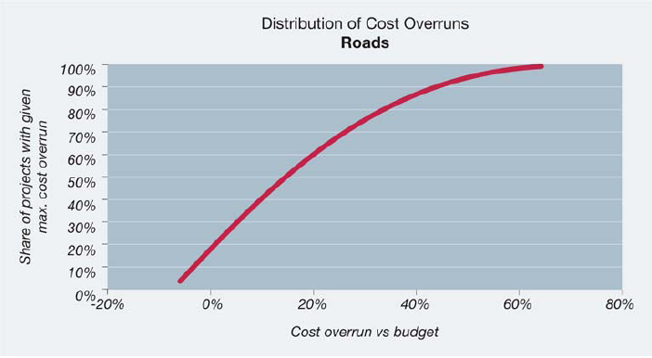
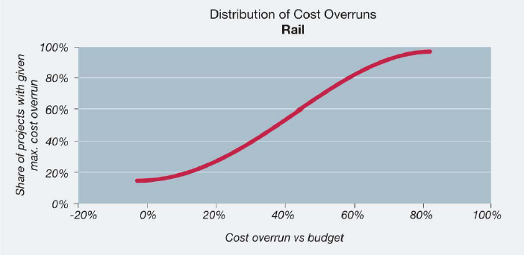
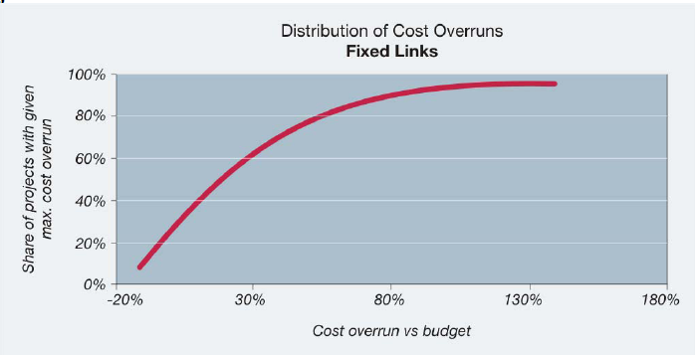
Countering the Planning Fallacy

Slide 4
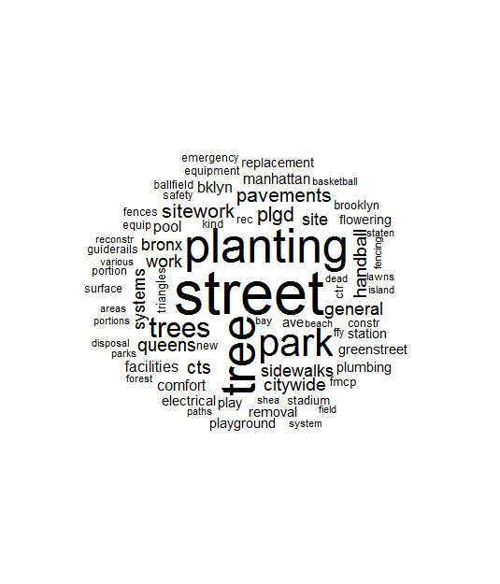
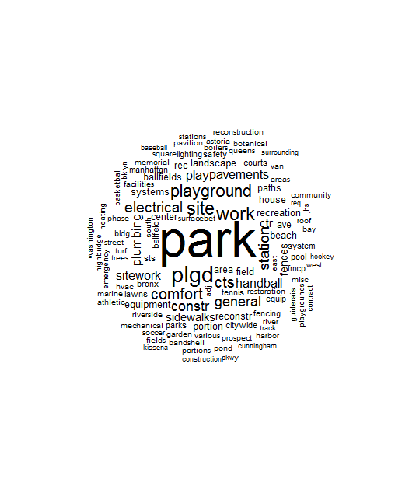
Using Text Analysis to Identify a Reference Class
Late
Not Late

Slide 5
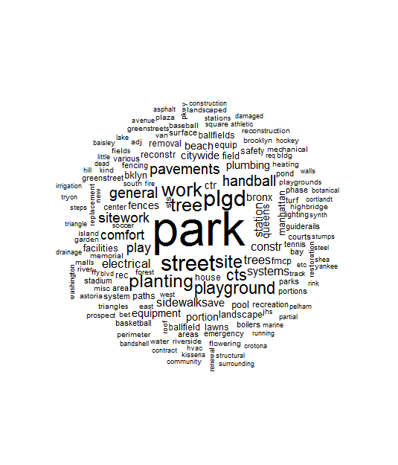
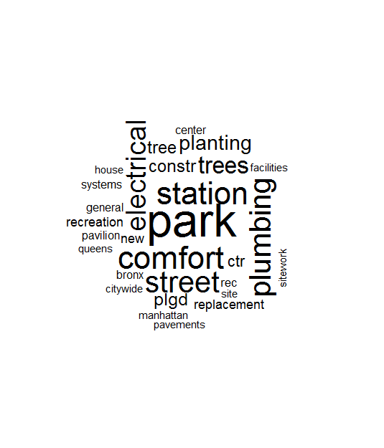
Using Text Analysis to Identify a Reference Class
Over budget
Not Over budget

Slide 6
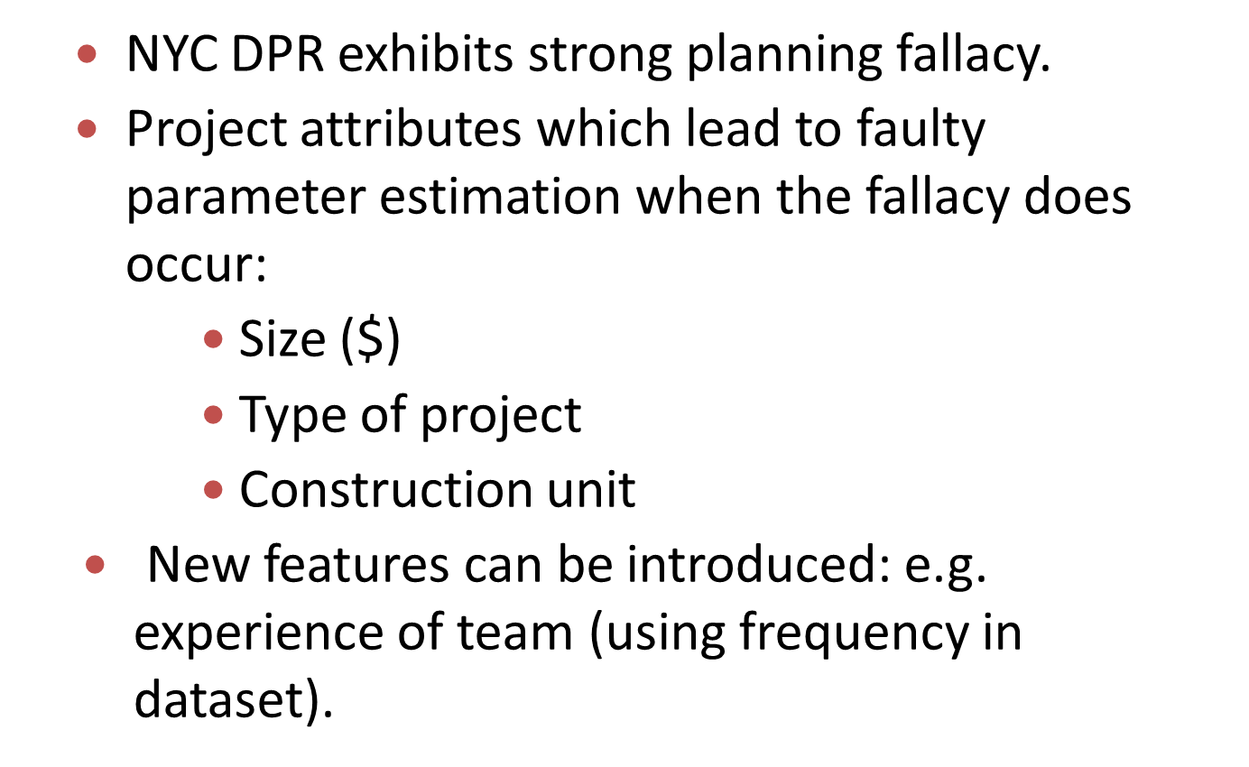
NYC DPR Observations

Slide 7
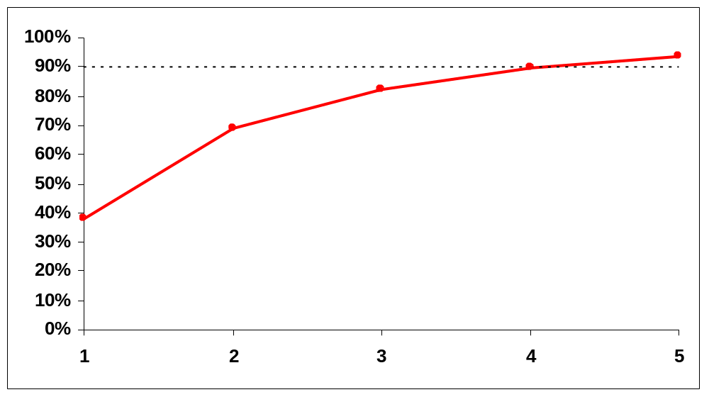
Multiple Experts

Slide 8
Implementations
Implementations of Reference class Forecasting and the Outside View:
  The British Department for Transport and Network Rail
  American Planner’s Association
  The Association of the advancement of Cost Engineering
Implementations of Wisdom of the Crowd
  Prediction Markets at Google, HP, Ford, etc.
  Planning Poker

